Slide 1

Gated Recurrent Units (GRU)

Slide 2
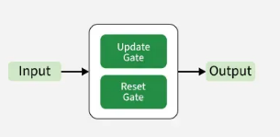
What are Gated Recurrent Units (GRU)
Gated Recurrent Units (GRUs) are a type of RNN introduced by Cho et al. in 2014. The core idea behind GRUs is to use gating mechanisms to selectively update the hidden state at each time step allowing them to remember important information while discarding irrelevant details. GRUs aim to simplify the LSTM architecture by merging some of its components and focusing on just two main gates:
Update gate
Reset gate.

Slide 3


Working of GRU
The GRU consists of two main gates:
Update Gate($Z_{t}$): This gate decides how much information from previous hidden state should be retained for the next time step.
Reset Gate($r_{t}$): This gate determines how much of the past hidden state should be forgotten.

Slide 4

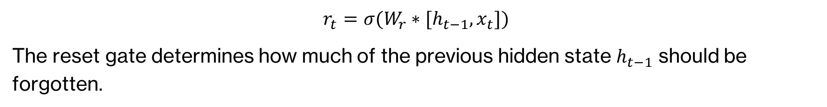

Reset gate:
$$r_{t}=σ(W_{r}∗[h_{t−1},x_{t}])$$
The reset gate determines how much of the previous hidden state $h_{t−1}$ should be forgotten.
Update gate:
$$z_{t}=σ(W_{z}∗[h_{t−1},x_{t}])$$
The update gate controls how much of the new information $x_{t}$ should be used to update the hidden state.

Slide 5
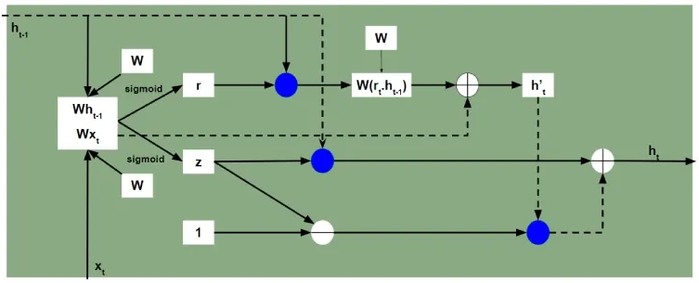
Working of GRU

Slide 6
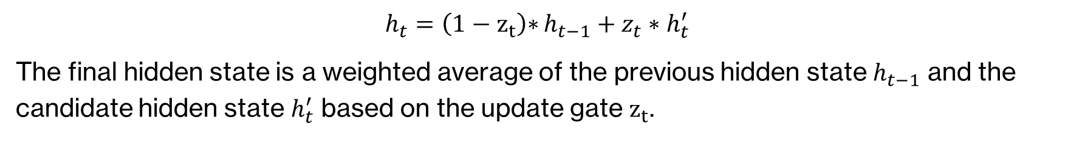
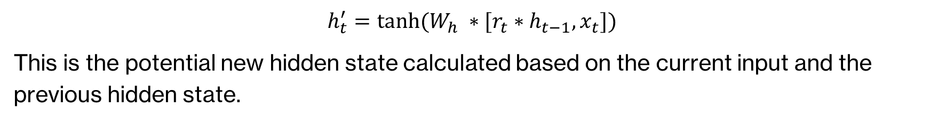
Candidate hidden state
$$h_{t}^{′}=tanh⁡(W_{h} ∗[r_{t}∗h_{t−1},x_{t}])$$
This is the potential new hidden state calculated based on the current input and the previous hidden state.
Candidate hidden state
$$h_{t}=\left(1−z_{t}\right){∗}h_{t−1}+z_{t}∗h_{t}^{′}$$
The final hidden state is a weighted average of the previous hidden state $h_{t−1}$ and the candidate hidden state $h_{t}^{′}$ based on the update gate $z_{t}$.

Slide 7

How GRUs Solve the Vanishing Gradient Problem
Like LSTMs, GRUs were designed to address the vanishing gradient problem which is common in traditional RNNs. GRUs help mitigate this issue by using gates that regulate the flow of gradients during training ensuring that important information is preserved and that gradients do not shrink excessively over time. By using these gates, GRUs maintain a balance between remembering important past information and learning new, relevant data.

